Slide 1
Mario Rossi 8 a 6 m

Slide 2
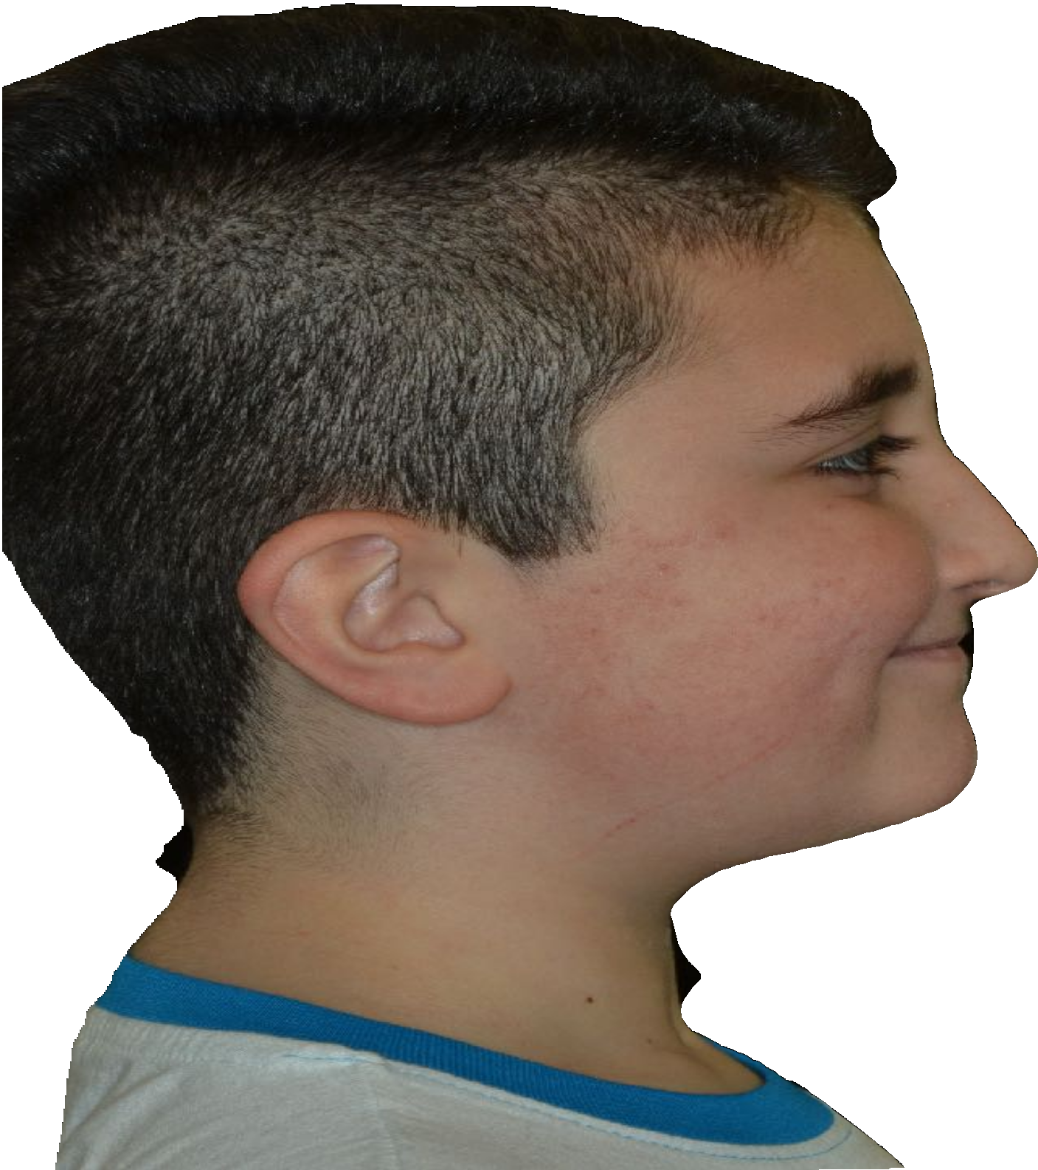
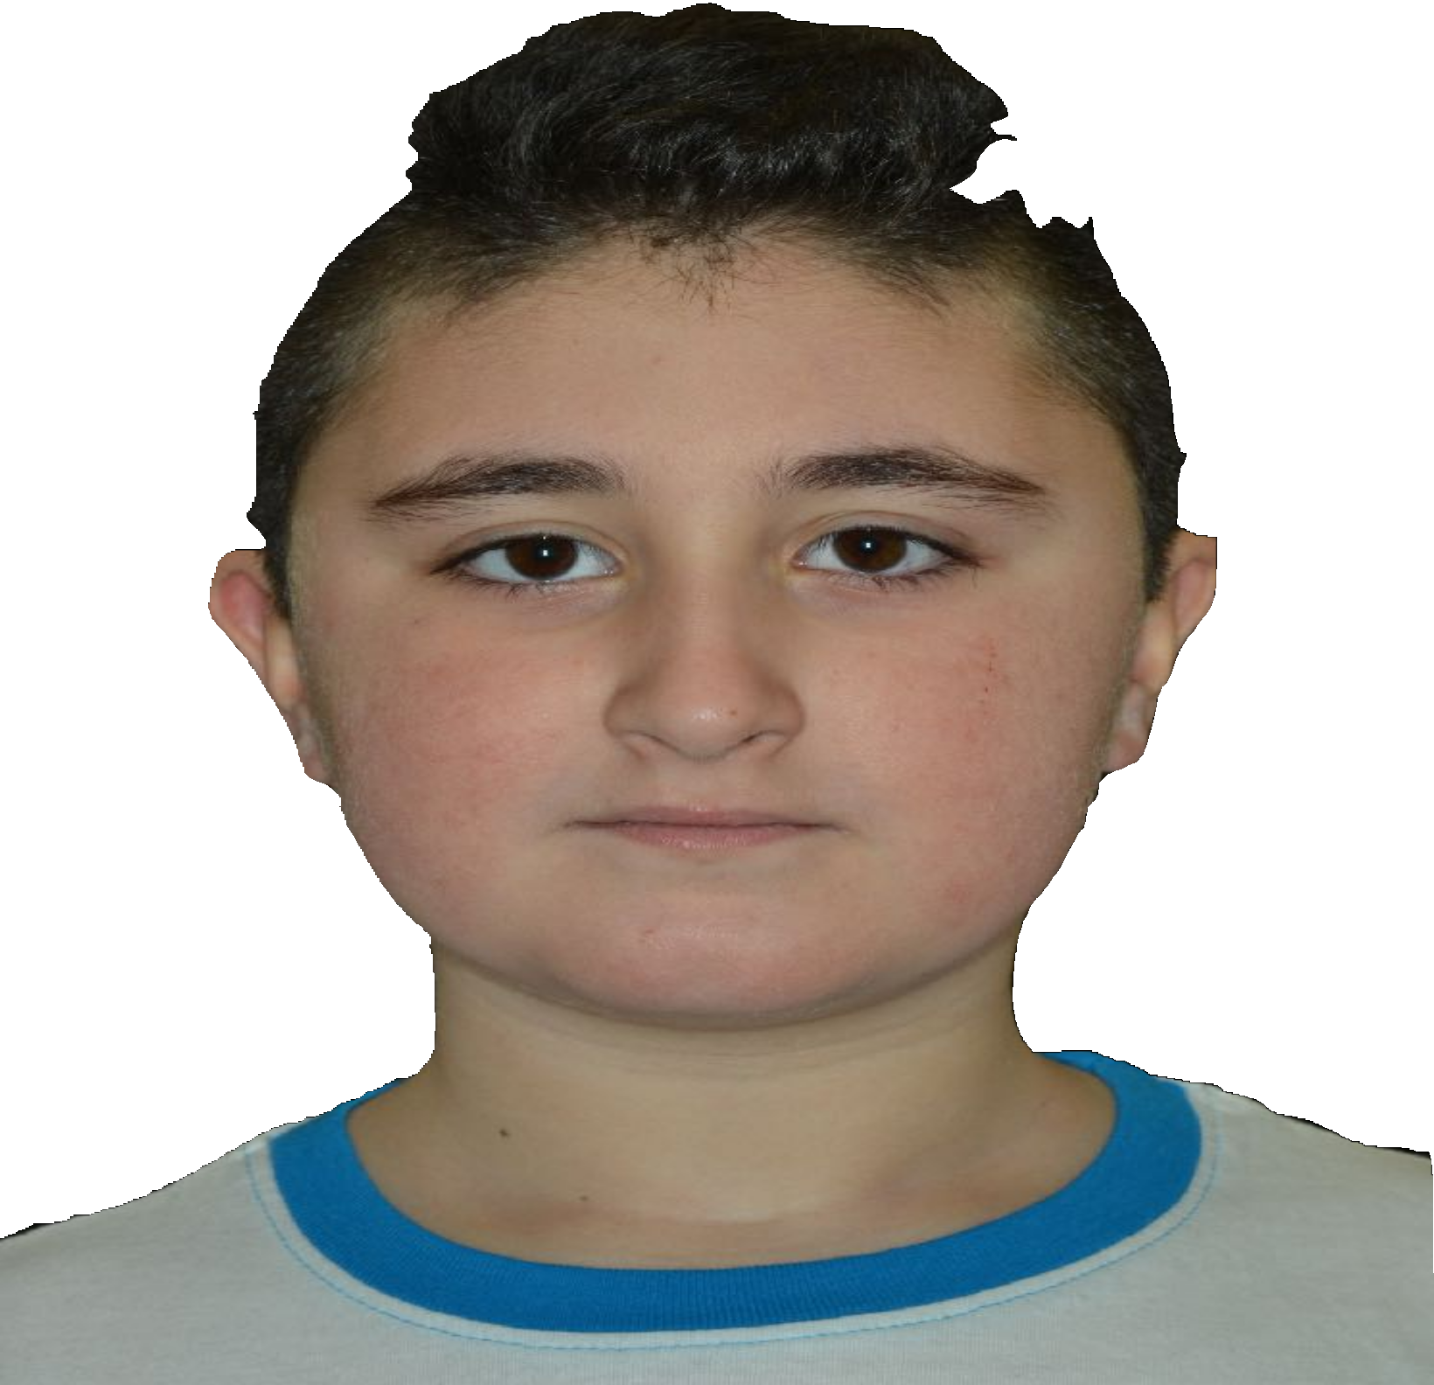
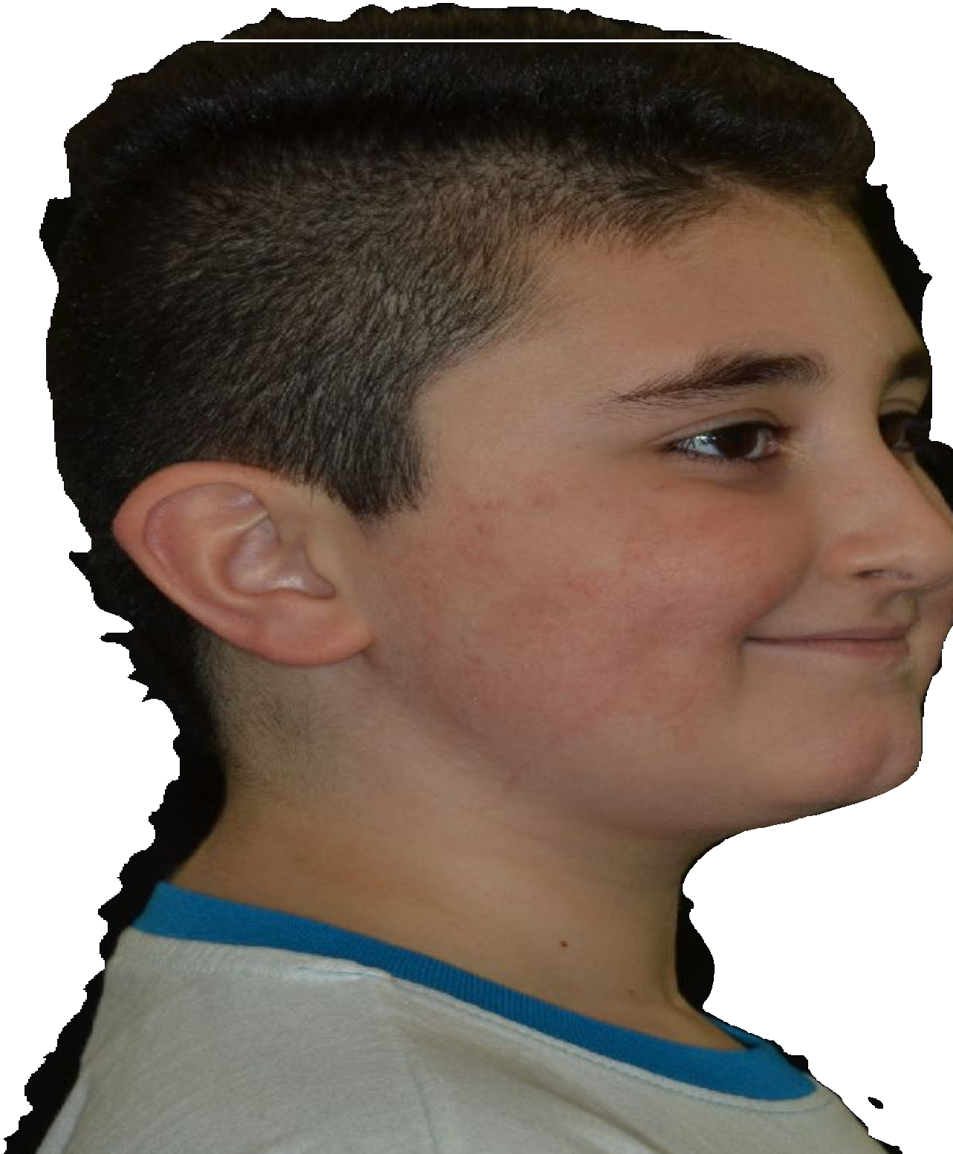

Slide 3
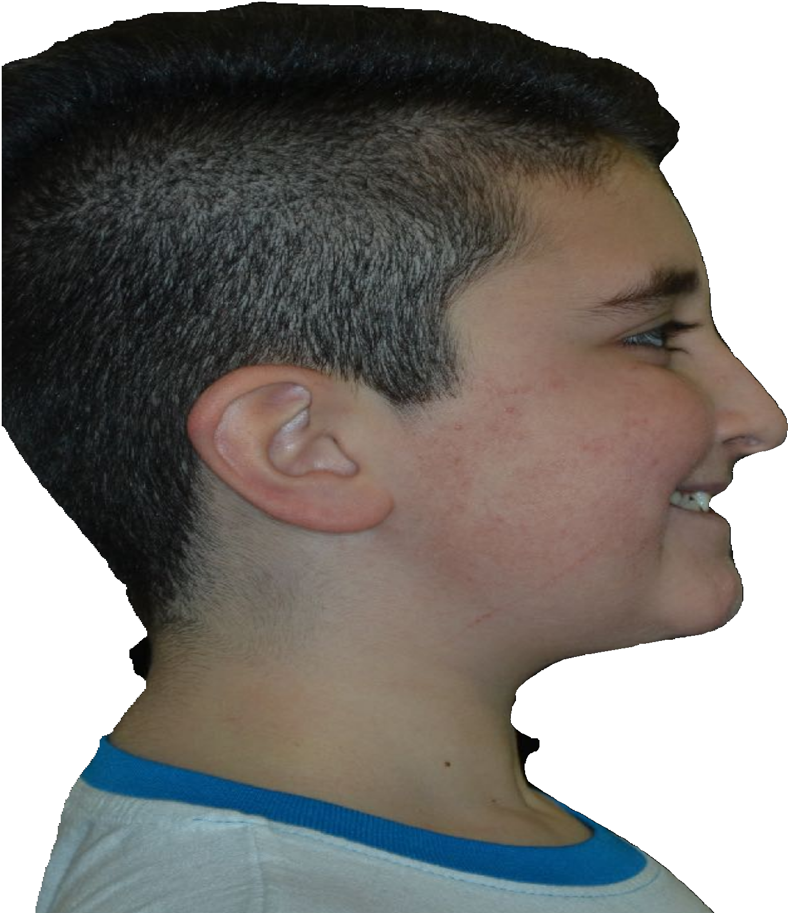
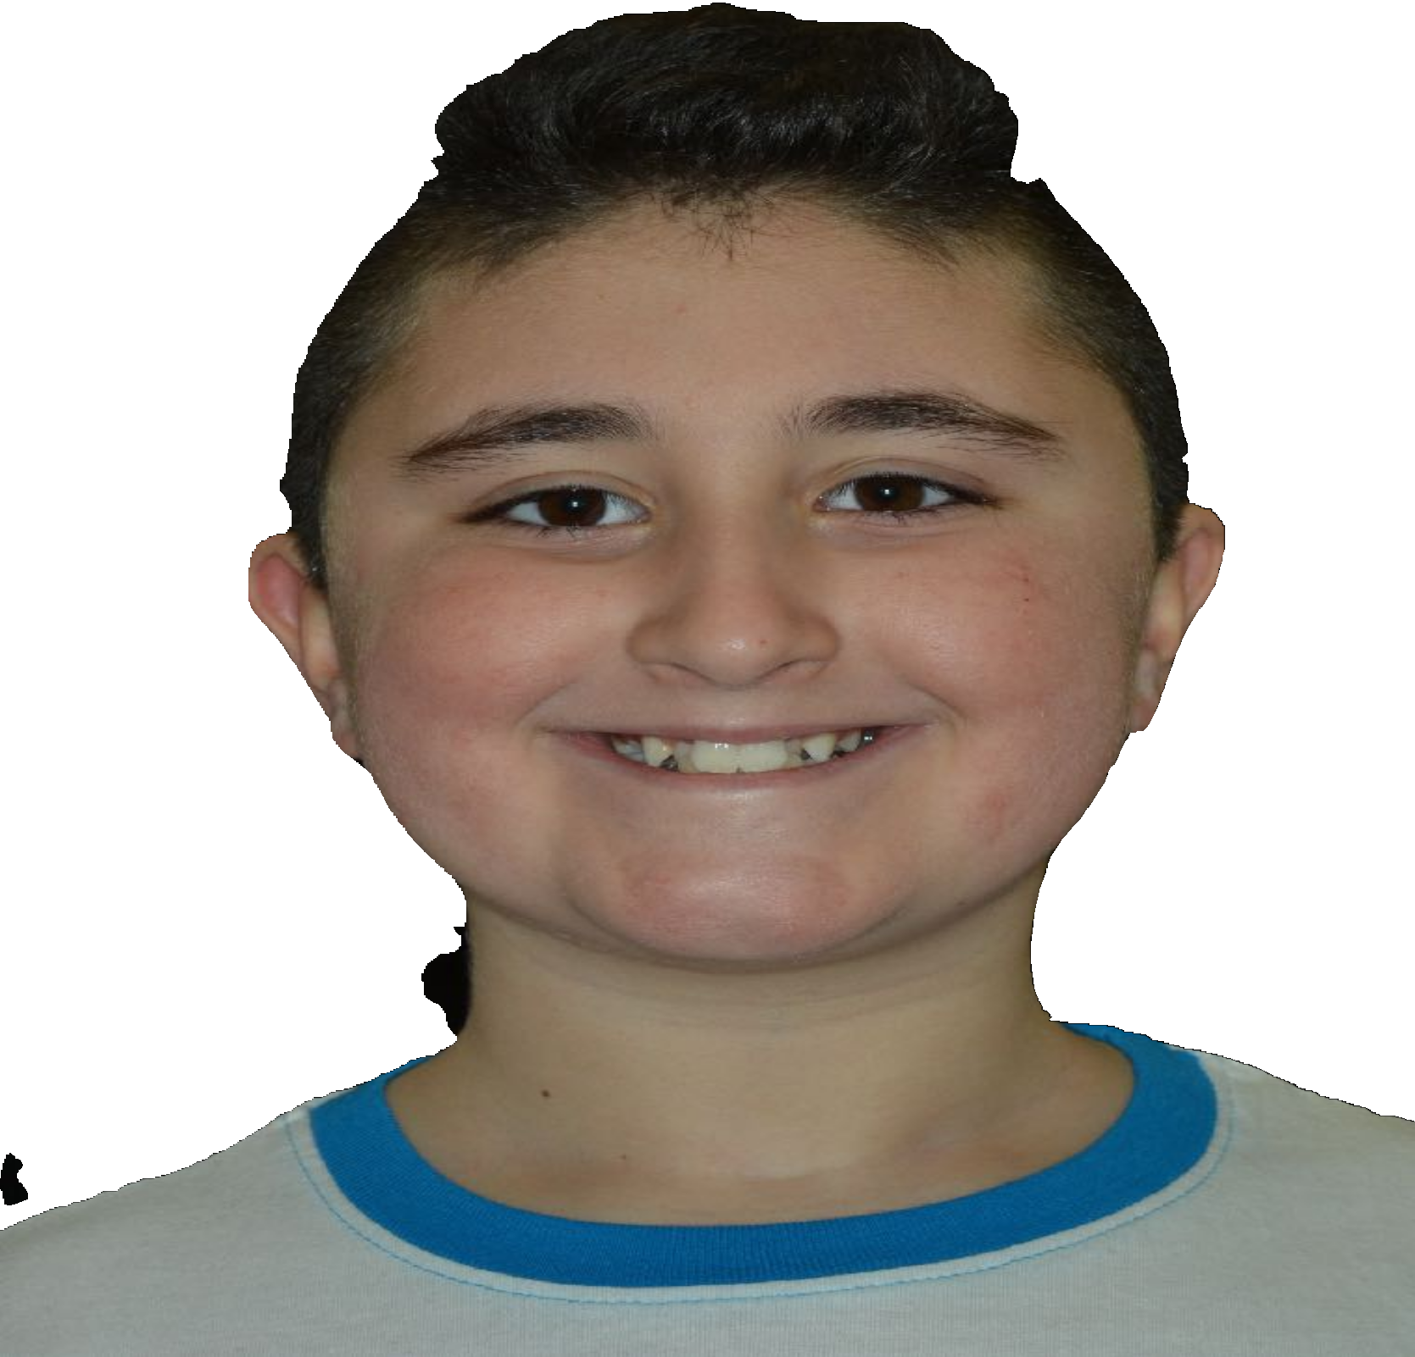
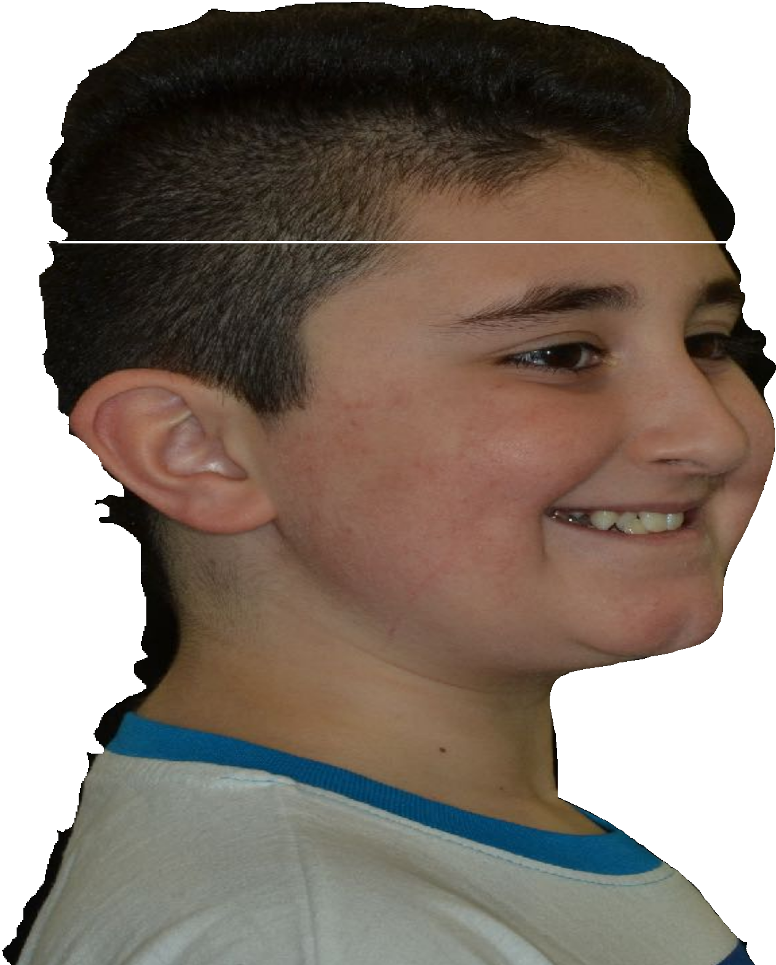

Slide 4
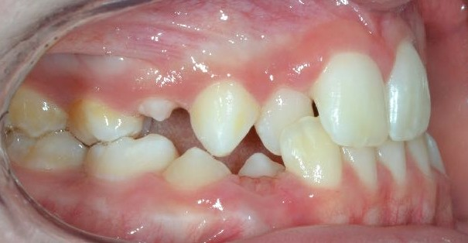
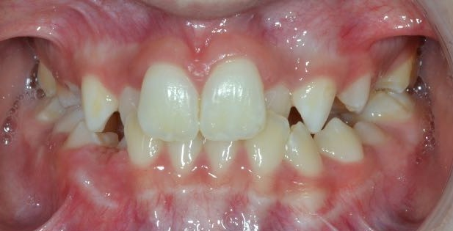
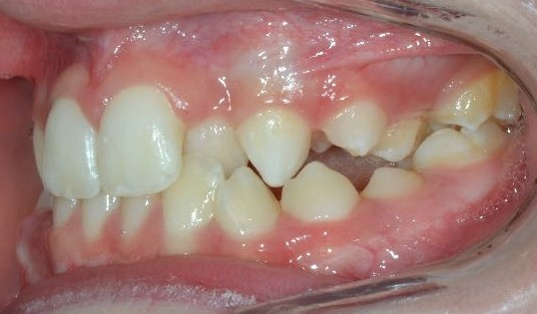
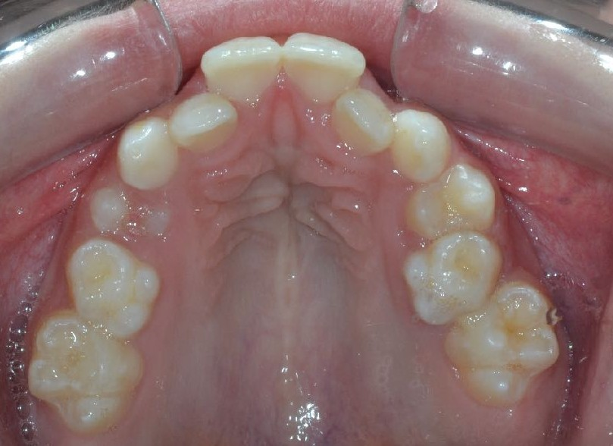
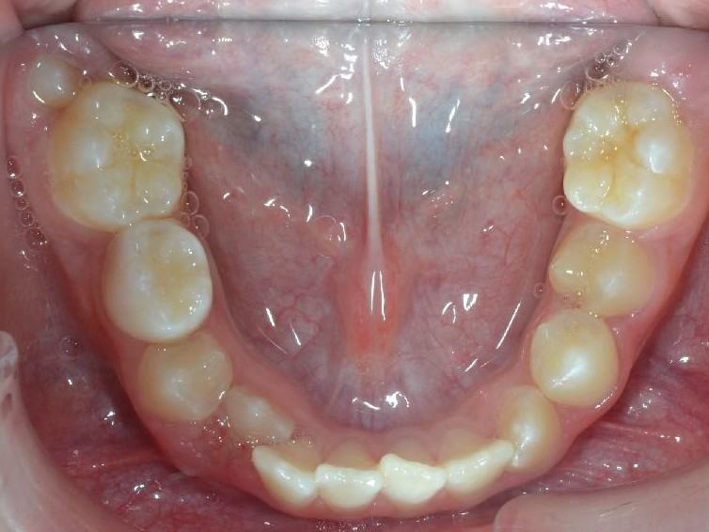

Slide 5
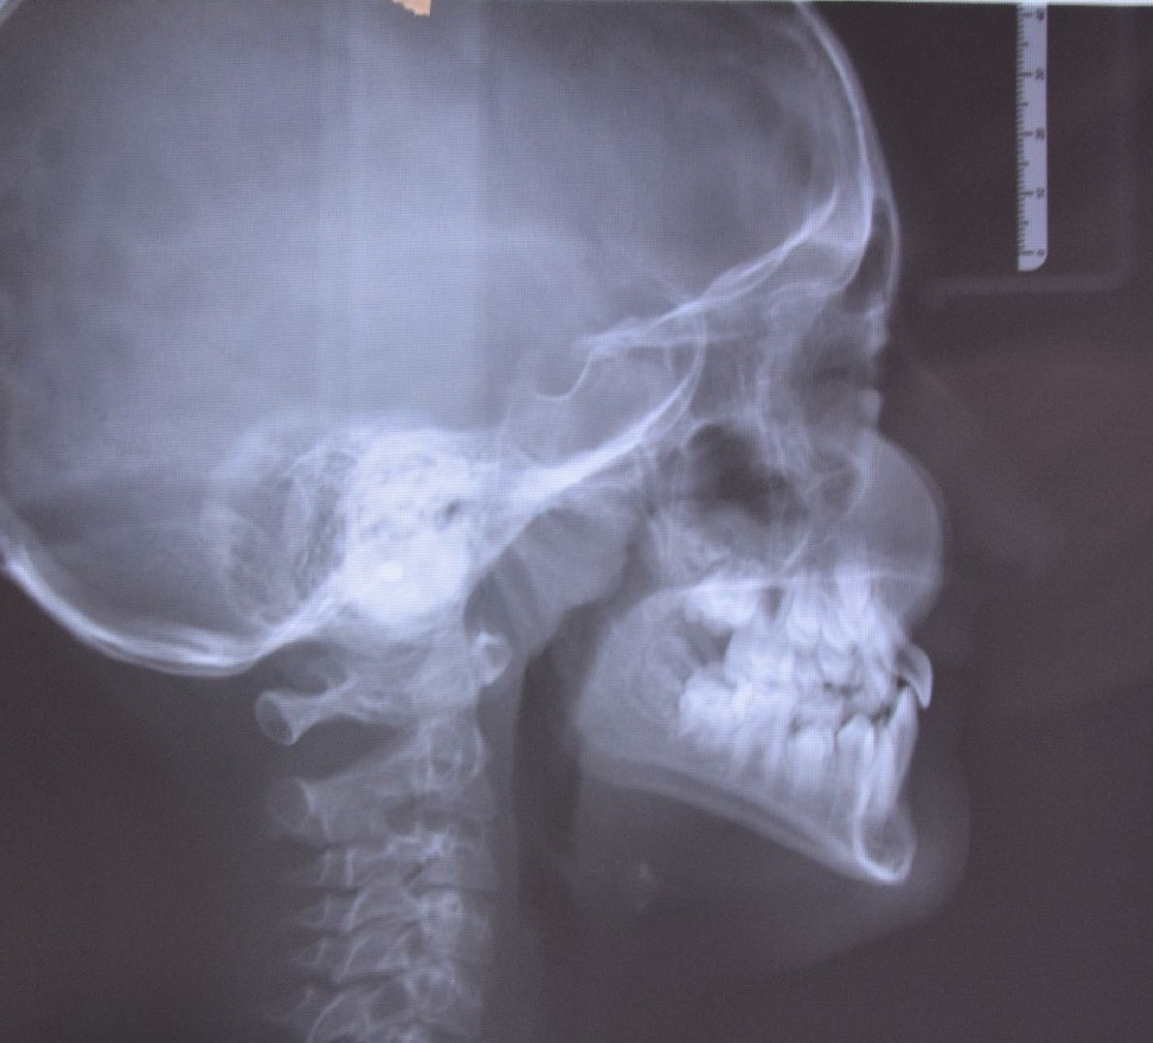
SNA | 77°
SNB | 81°
ANB | - 4°
A-N/Fh | - 3 mm
Po-N/Fh | -2 mm
Wits | - 4 mm
Sn-GoGn | 36°
Fh-GoGn | 30°
ANS/PNS-GoGn | 31°
1 sup - A Pog | 2 mm
1 inf - A Pog | 0 mm
1 sup/Max Plane | 117°
1 inf /Mand Plane | 86°
OVJ | 2mm
OVB | 2 mm

Slide 6
